Slide 1

Unit 2

Slide 2



Slide 3


Slide 4


Match the new words and expressions with their meanings.

Slide 5

1. At first the English spoken in England between about AD 450 and 1150 was very different from the English spoken today.
2. Today the number of people learning English in China is increasing rapidly.

Slide 6
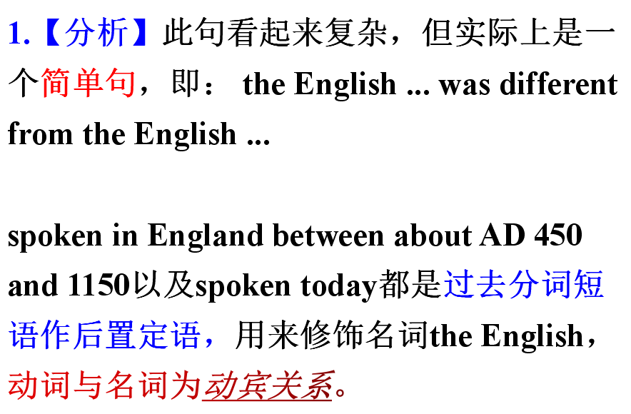

Slide 7
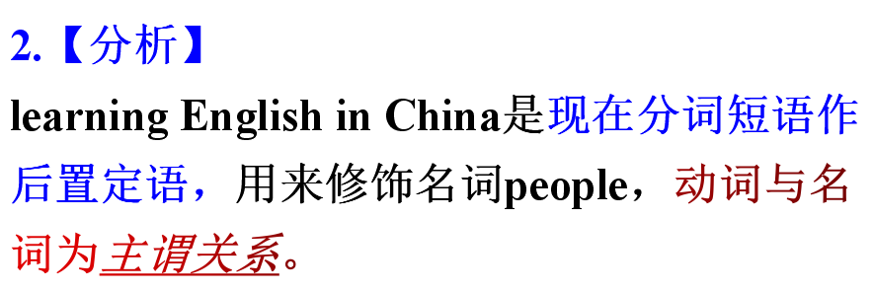

Slide 8
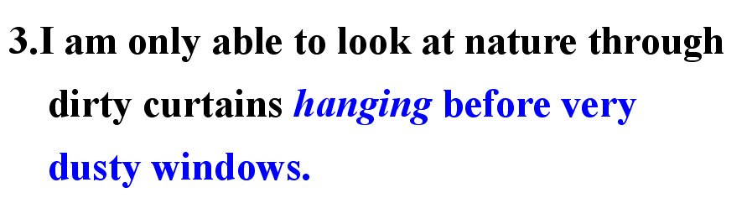

Slide 9
1. The speech ______(give) by that
professor was a great success.
2. The house _____(build) there is mine.
3. The girl ______(stand) there is my sister.
4.Most of the artists ______(invite)to the party are from South Africa.
5.The boy ____(name) Jim is my brother.
6.The student ____(read) books carefully may be reading a novel.

Slide 10
... India has a very large number of fluent English speakers... Today the number of people learning English in China is increasing rapidly.
……印度有众多讲英语很流利的人……如今在中国，学习英语的人数正在迅速增长。

Slide 11
“a number of” VS “the number of”
a number of ： “很多， 许多” ，指数量
后接可数名词
作主语时， 谓语动词用复数。
the number of ： “……的数目”， 指总量
作主语时当作一个整体，谓语动词用单数。 number用large， small来修饰。

Slide 12
即学即练
1) There ____(be) _______________ ( a number of / the number of ) people walking in the park after supper.
2)____________( a number of / the number of ) of books missing from the library _____(be) large.

